Slide 1


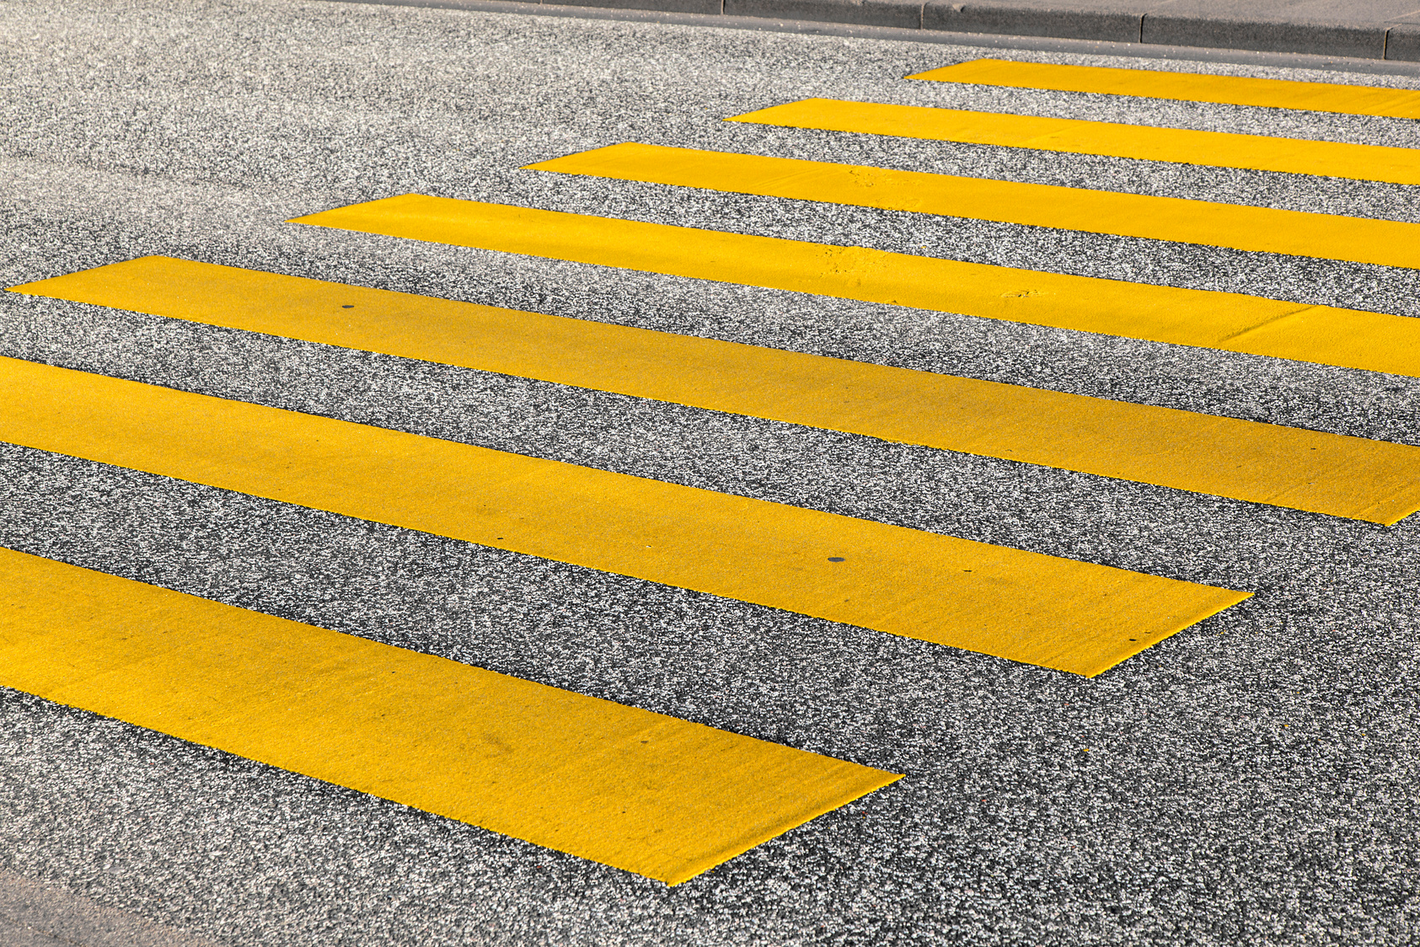

Pedestrian
Crashes
ANALYZING THE DATA OF PEDESTRIAN ACCIDENTS

Slide 2
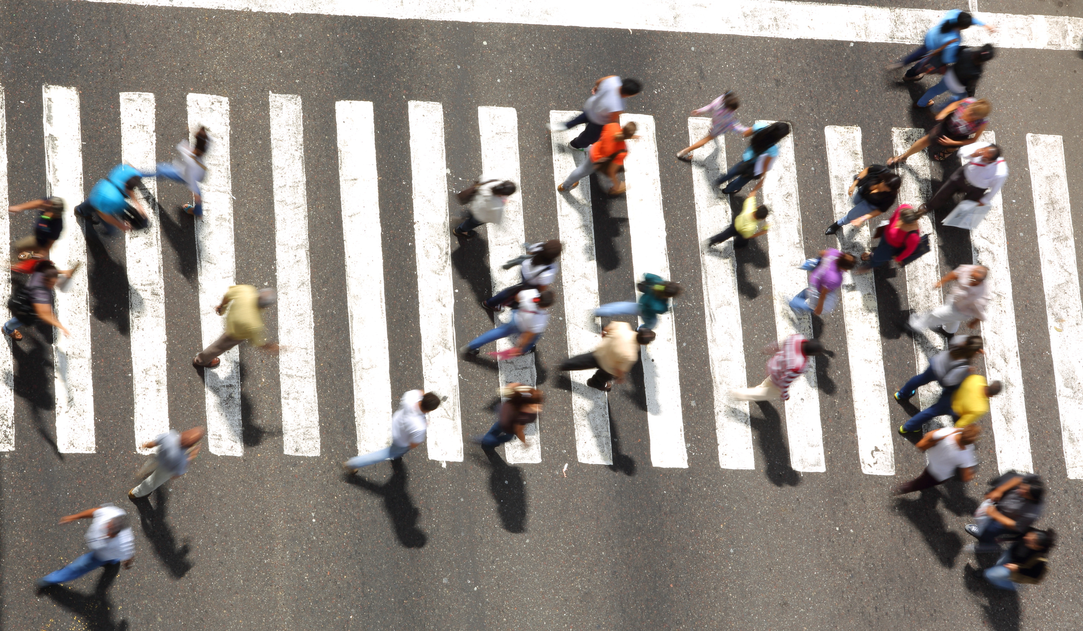



SYNOPSIS
Our project “Pedestrian Crashes” compiles and analyzes data related to pedestrian-involved crashes reported since 2012, as documented by the Australian Federal Police (AFP) through the AFP Crash Report Form.
In this project we provide insights into pedestrian safety and accident patterns in Australia to improve public safety with data-driven decisions.
CANBERRA

Slide 3
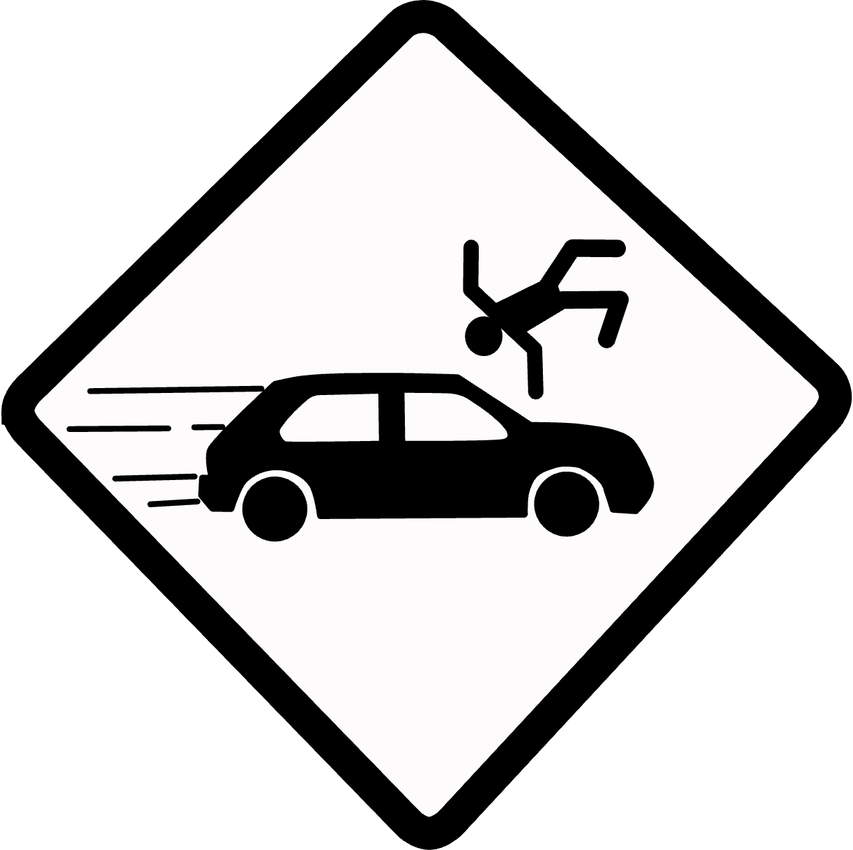


PURPOSE
ANALYZE CRASH DATA
In This project we collects, cleans, and organizes pedestrian crash data reported by the police or the public. By doing so, it seeks to identify trends, hotspots, and contributing factors to pedestrian accidents.
ENHANCE SAFETY MEASURES
Enhance Safety Measures: Through data-driven insights, our project strives to contribute to improved pedestrian safety measures. The findings may help authorities and urban planners make informed decisions regarding road infrastructure, signage, and traffic regulations.
RAISE AWARENESS
By making this data accessible to the public and researchers, this project aims to raise awareness about pedestrian safety issues. It encourages discussions and initiatives to reduce pedestrian accidents and improve road safety. This repository serves as a valuable resource for anyone interested in pedestrian safety, urban planning, or road safety initiatives in Australia. It is a starting point for data-driven analysis and discussions aimed at making our streets safer for pedestrians.

Slide 4





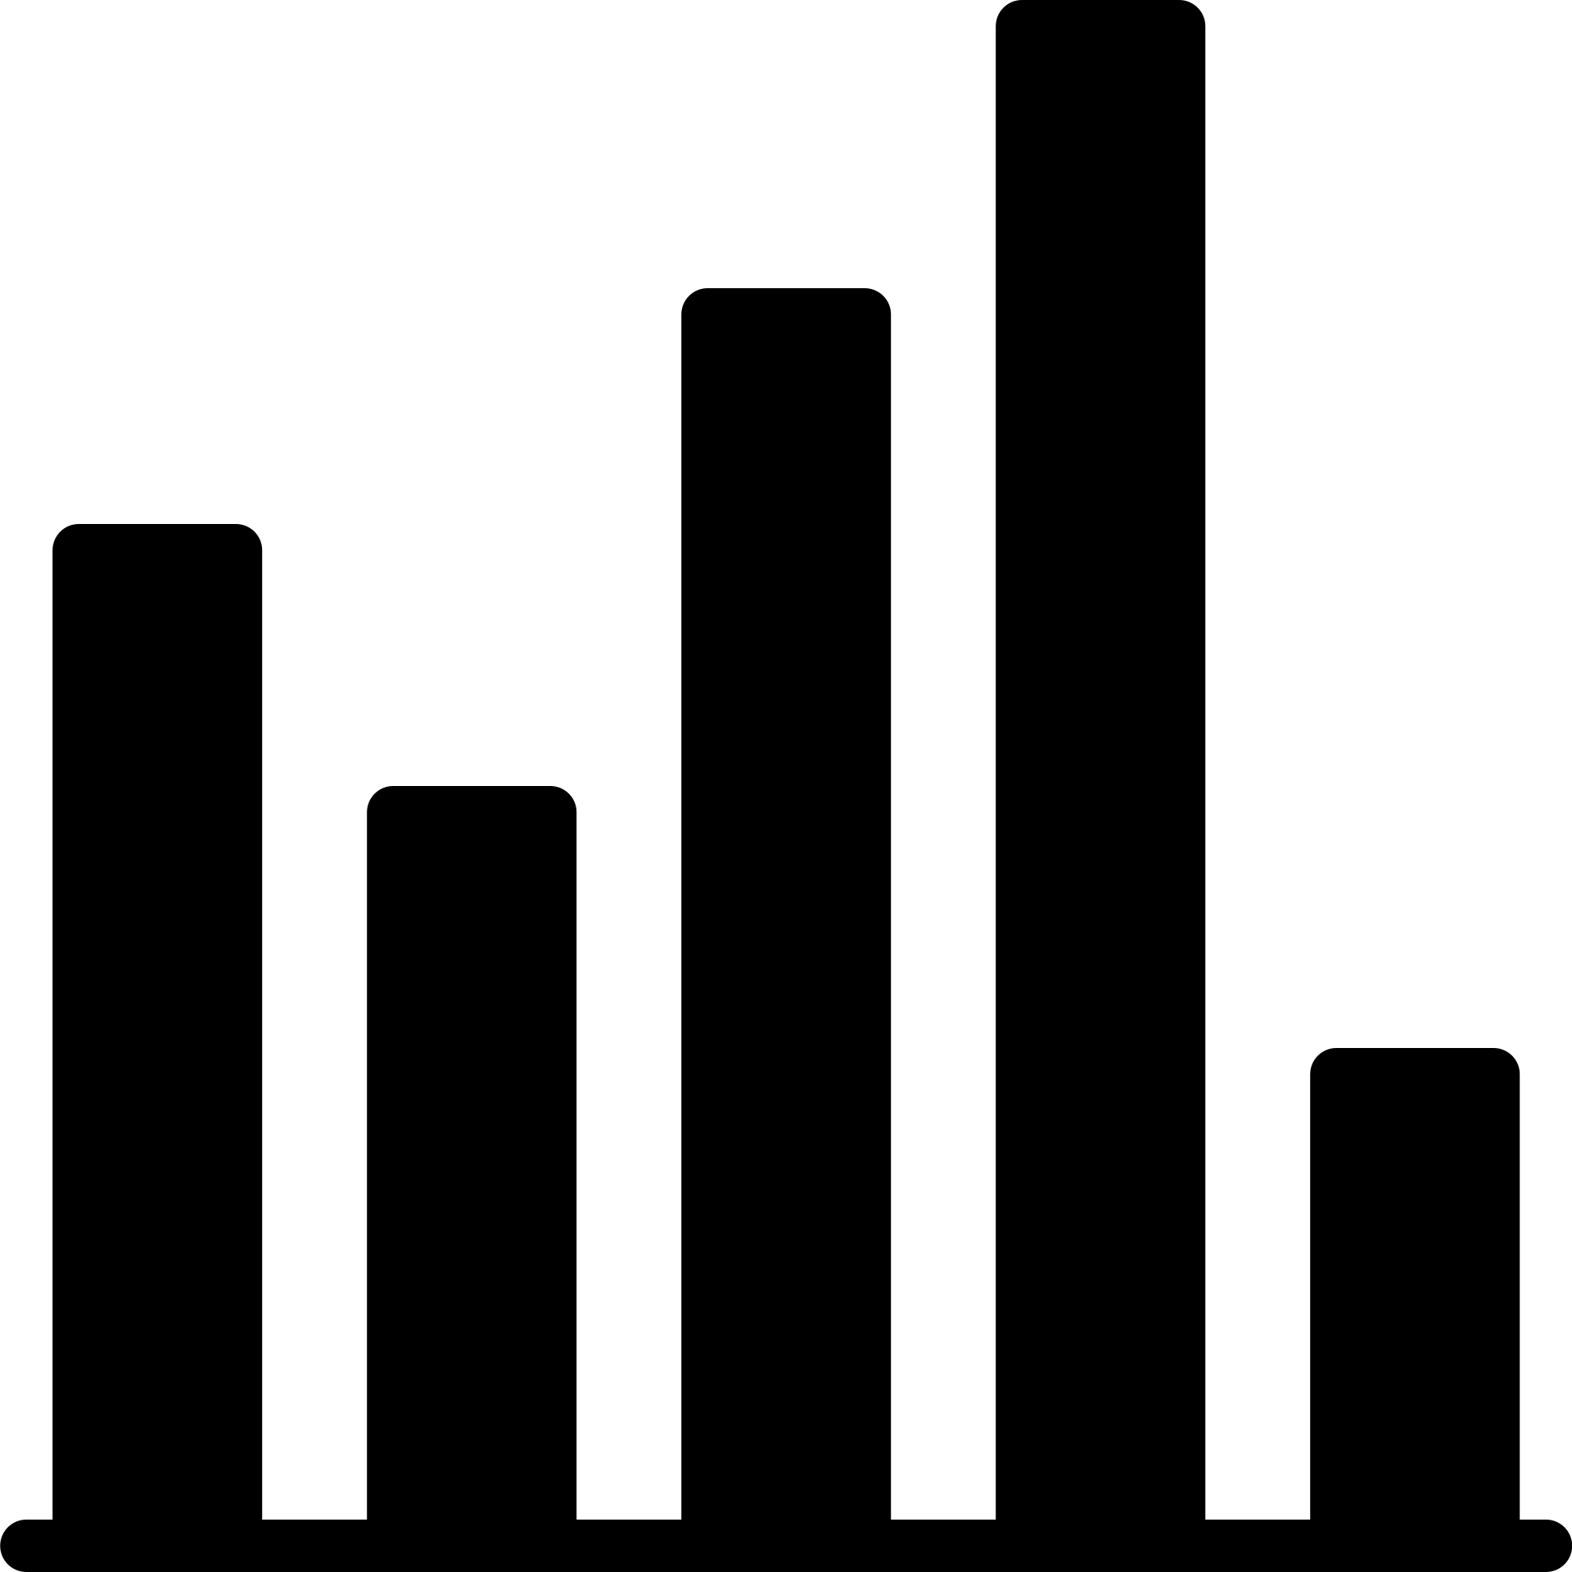
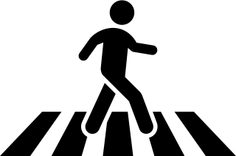












DATA PIPELINE
Our project combined data processing, database management, web development, and data visualization to promote pedestrian safety awareness.
Users could interact with the web app, access various pages, and visualize crash data.
Developed a Flask web application with HTML, CSS, and Bootstrap for the user interface.
Created an SQLite database to store the cleaned data.
Collected and processed crash data in Jupyter Notebook.
Utilized Python
for data transformation and conversion.
Integrated the database using SQLAlchemy and displayed visualizations using Chart.js.
Emphasized pedestrian safety by highlighting "Struck pedestrian (On Road)" accidents.

Slide 5


DATA
VISUALIZATIONS

Slide 6
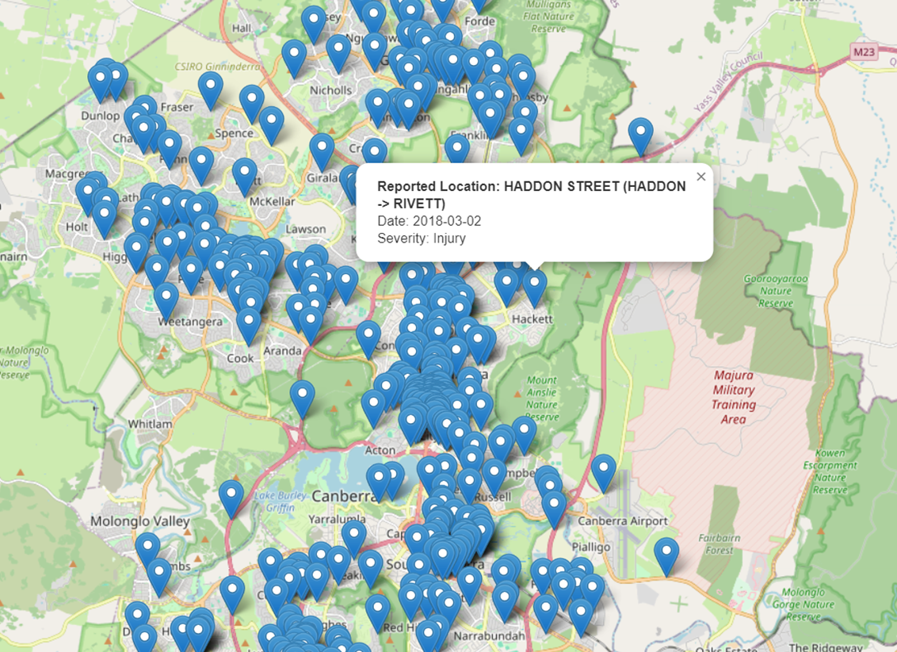
MAP
The map displays the crash locations marked with the icon which allows users to explore the map. By clicking on markers to view specific crash details, and gain insights into the geographical distribution of accidents.

Slide 7
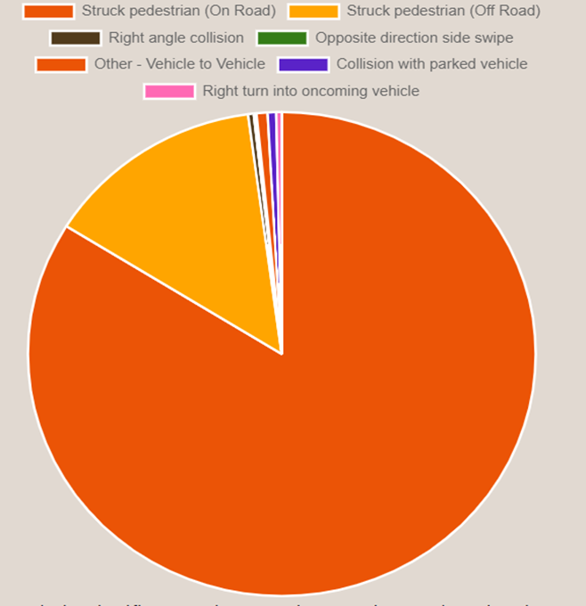
PIE CHART
The pie chart highlights the prominence of "Struck Pedestrian (On Road)" incidents, showing the imperative for enhanced pedestrian safety measures.
This visual representation is derived from comprehensive crash data analysis, placing significant emphasis on fostering awareness and advocating for proactive measures to augment pedestrian safety.

Slide 8
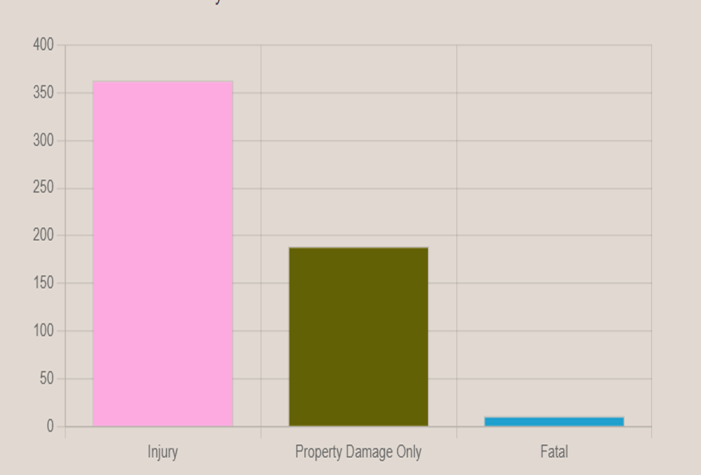
BAR CHART
The bar chart shows various categories of accidents, providing valuable insights for safety assessments and informed decision-making. It is essential to note that the specificity of insights derived from the chart is contingent upon the content of the dataset, which regrettably is not included in the provided code
This chart enables easy comparison of crash type frequencies, aiding in the identification of common types and offering insights for safety assessments and decision-making. However, the specific insights drawn from the chart depend on the dataset's content, which is not provided in the code.

Slide 9
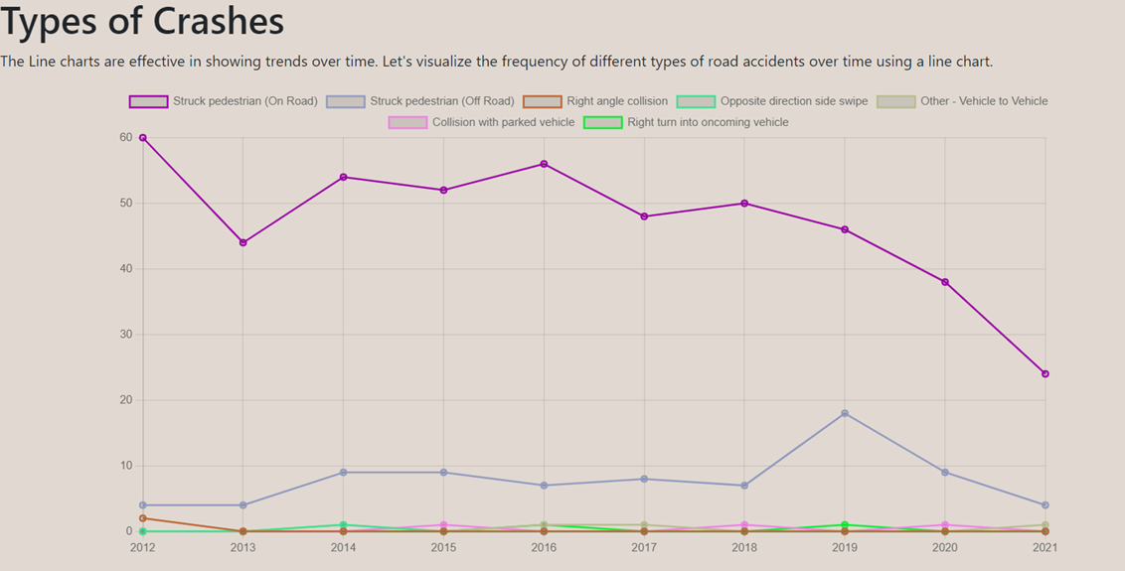
LINEAR
The different line charts effectively show crash trends over time and allows you to understand the different types of accidents and their relation to time and frequency.

Slide 10
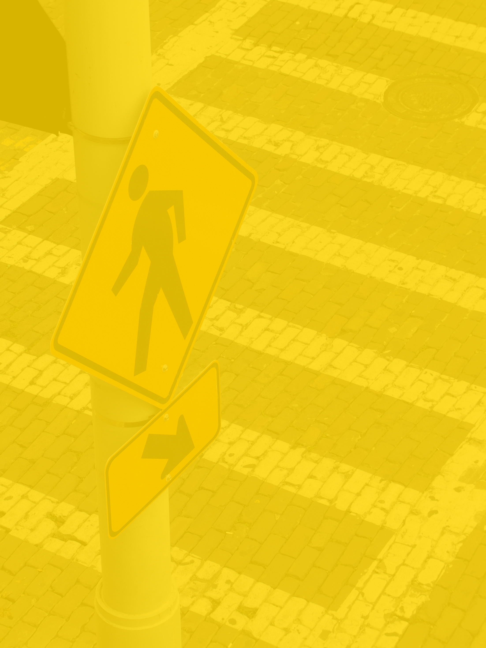
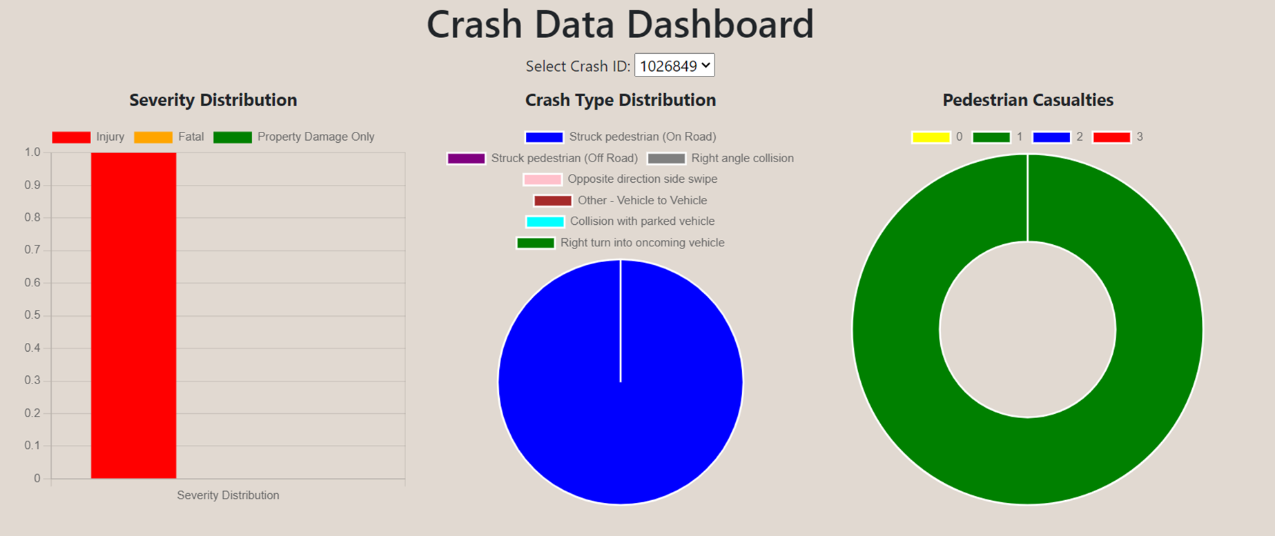

Slide 11


CONCLUSION
IN CONCLUSION our project successfully leveraged data collection, processing, storage, web development, and data visualization to create a comprehensive platform for analyzing and promoting road safety. Through the integration of Flask, SQLite, Chart.js, and Leaflet, we not only organized and stored crash data efficiently but also presented it in a user-friendly manner. The bar chart and interactive map allowed users to gain insights into the frequency and spatial distribution of different crash types, offering valuable information for safety assessments and decision-making.
01
FURTHERMORE, it is also highlighted the pressing issue of "Struck pedestrian (On Road)" accidents, underscoring the need for enhanced pedestrian safety measures. The visualization components served as powerful tools for raising awareness and advocating for proactive measures to reduce accidents and protect pedestrians.
02
ULTIMATELY, our project showcased the potential of data-driven insights and user-friendly web interfaces in addressing road safety concerns. It exemplified how technology and data visualization can contribute to informed decision-making and contribute to the collective effort to create safer road environments for everyone.
03

Slide 12
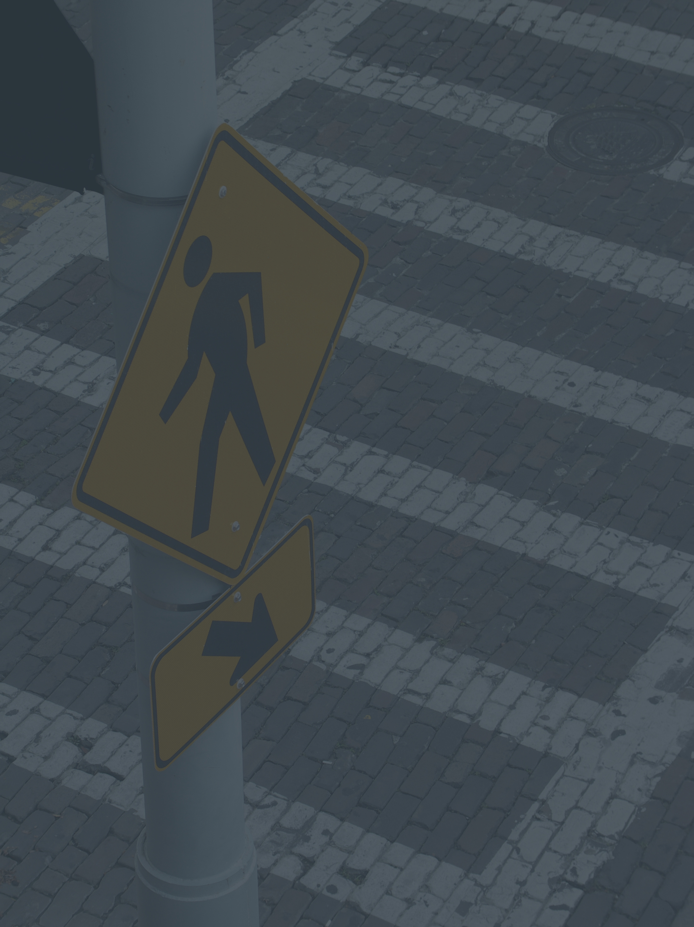
QUESTIONS?

